Slide 1


Teacher/Staff Engagement Survey
Result and Analysis
Eagle Mountain-Saginaw ISD
October 2012 - January 2023

Slide 2
Overview
Engagement is the sense of connection that individuals have with their profession in general and with their current jobs in particular. Several factors at individual school sites impact teachers’ level of engagement, including aspects of the working environment such as relationships with school administration, colleagues, students, and parents; the physical work conditions; feeling of personal safety; policy considerations and implementation; support for personal development and growth; prior preparation; perceptions of personal relevance; and satisfaction.
This study was conducted to accomplish three goals:
Measure the level of engagement among teachers.
Identify which groups of teachers are less engaged.
Identify areas where engagement can be improved.
With this information, we hope to improve conditions so that all teachers at Loudoun County Public Schools are fully engaged in their profession. Fully engaged teachers are key to helping all students achieve to their full potential. Because more engaged individuals likely completed the survey, this data may overestimate engagement among employees district-wide.
*

Slide 3
Study Design
All members of the school staff were invited to complete the engagement survey. Teachers were invited via email with a unique link to complete the survey. The survey consisted of three parts:
Engagement Scale
designed to measure each staff members’ level of engagement. Based on responses to these questions, an “Engagement Score” was computed for each respondent.
School/Workplace items
measure a range of factors within the school environment that may impact engagement.
Respondent Background items included grade level & subject taught as well as gender.
was comprised of 8 items that were specifically
included 8 items that were designed to
*

Slide 4
Technical Notes
This study was conducted as a census survey. That is, all teachers were invited and encouraged to participate thereby giving all teachers an opportunity to express their views. If all teachers participate, a complete picture of engagement results and survey data will be highly accurate.
Whether an individual completes the survey is related to his/her level of engagement. Those teachers who decline to participate generally include teachers who are less engaged in their work. Therefore, low levels of participation:
indicates low teacher engagement in general, and
survey findings will overestimate the level of engagement.
However, 100% participation is unlikely and we have a response rate of 69%.
*

Slide 5
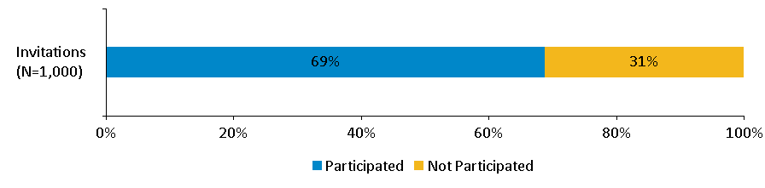
Response Rate
Response Rate = 69%
*

Slide 6
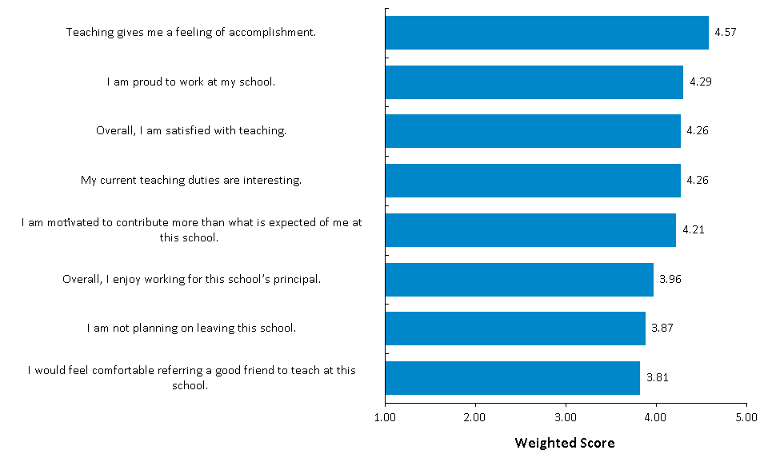
Engagement Scale Items
*

Slide 7
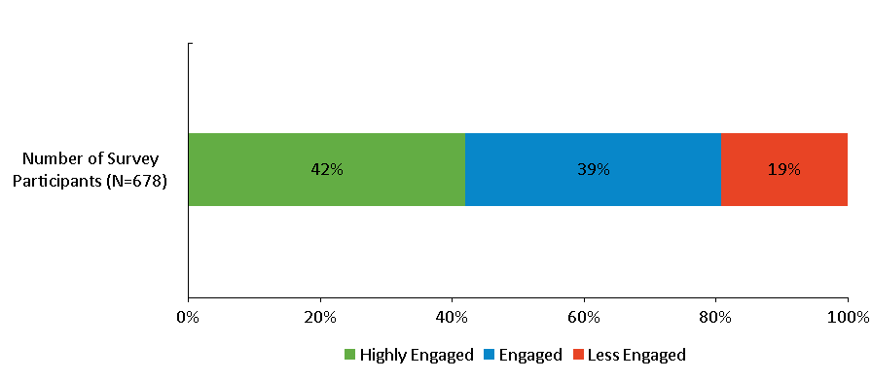
Overall Level of Engagement
*

Slide 8
Where Should Efforts be Focused to Improve
Staff Engagement?
Fifty-two items examined aspects of the school/workplace environment to find areas of focus to help improve engagement. Each area was rated on a five-point scale, with higher values indicating a stronger level of agreement.
The relationship between each employee’s ratings and his/her overall engagement score was also examined. To do this, correlation coefficients were computed between the engagement scores and each school/workplace item. A correlation coefficient is a measure of how strongly two items are related to each other. The value can range from -1.0 to 0 to +1.0. The closer to ±1.0, the stronger the relationship.
Based on the combination of ratings and correlation with engagement, the areas were classified as high vs. low in ratings and high vs. low in relation to engagement. The relation to engagement is based on a median rating to engagement of 0.46.
Those areas that were rated low, but had a strong correlation with engagement (red), should receive primary focus. The secondary area contains items that had high ratings and a strong correlation with engagement (yellow).
 |  | Correlation to Engagement
 |  | Strong | Weak
Driver Rating | Low | PRIMARY FOCUS
 | High | SECONDARY FOCUS
8

Slide 9
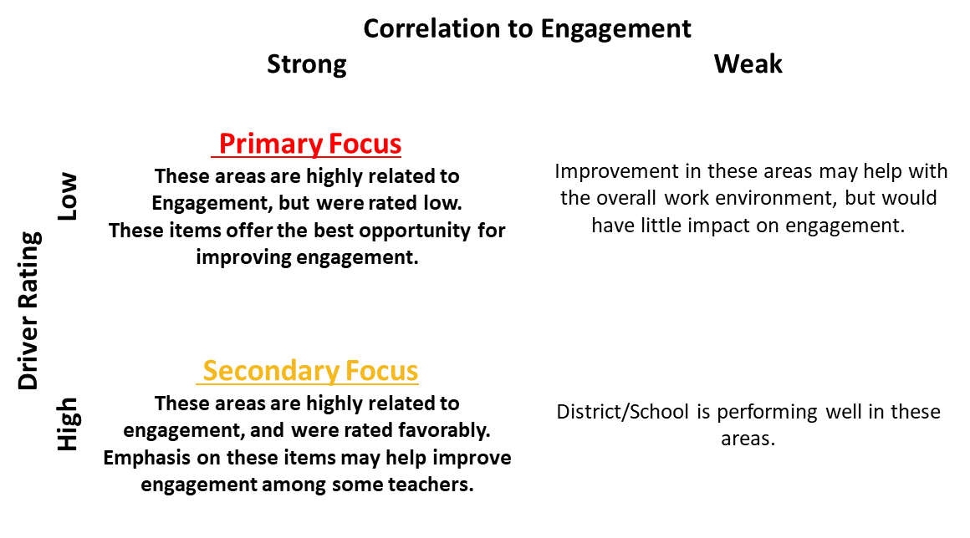
Where Should Efforts be Focused to Improve
Staff Engagement?
9

Slide 10
Where Should Efforts be Focused to Improve Staff Engagement?
 | Survey Item | Driver Rating | Correlation to Engagement
 | The school policies meet my needs as a teacher. | 3.74 | 0.73
 | The school administrators make good decisions for the school overall. | 3.82 | 0.77
Correlation To Engagement
 |  | Strong | Weak
Driver Rating | Low | Primary Focus
 | High | Secondary Focus
Median
Driver Rating | 3.95
Correlation To Engagement | 0.54
*

Slide 11
Where Should Efforts be Focused to Improve Staff Engagement?
 | Survey Item | Driver Rating | Correlation to Engagement
 | I enjoy the relationships I have with the school administrators. | 3.96 | 0.79
 | My physical safety is protected at school. | 4.14 | 0.58
Correlation To Engagement
 |  | Strong | Weak
Driver Rating | Low | Primary Focus
 | High | Secondary Focus
Median
Driver Rating | 3.95
Correlation To Engagement | 0.54
*

Slide 12
Where Should Efforts be Focused to Improve Staff Engagement?
 | Survey Item | Driver Rating | Correlation to Engagement
 | The school supplies all the resources that I need to effectively teach my students. | 3.26 | 0.50
 | The classrooms where I teach are physically comfortable. | 3.94 | 0.41
Correlation To Engagement
 |  | Strong | Weak
Driver Rating | Low | Primary Focus
 | High | Secondary Focus
Median
Driver Rating | 3.95
Correlation To Engagement | 0.54
*

Slide 13
Where Should Efforts be Focused to Improve Staff Engagement?
 | Survey Item | Driver Rating | Correlation to Engagement
 | I fill a necessary role in the learning and growth of my students. | 4.64 | 0.46
 | I am a positive influence on my students. | 4.70 | 0.41
Correlation To Engagement
 |  | Strong | Weak
Driver Rating | Low | Primary Focus
 | High | Secondary Focus
Median
Driver Rating | 3.95
Correlation To Engagement | 0.54
*

